Slide 1
Disease Prediction System
domain – Machine Learning.

Slide 2

01
Agenda 1
Introduction to Project Concept
Topic Concept || Tools and Technology
Agenda
For
Presentation
03
Agenda 3
Project Flow and Working
Flow || Working || Output
Agenda 4
04
Application , Future Scope Advantages ||disadvantages || Application|| Future Scope

Slide 3


Meet Our Team
Disease Prediction System
Project Team
Achal Rajesh Mate
TY CSE IS-3
DEEP LEARNING
Pushkar Ashok Narkhede
TY CSE IS -3
Ritu Kumari
TY CSE IS - 3
Guided By
Guide 1 : Prof. Rajeshree Nayak

Slide 4
Introduction
Diseases are most common medical issue all over world, many disease such as cancer, heart disease and so on cause to death if they are not predicted at the earlier stage.
The aim of this project is to built a system where the system predict variety of disease
Disease Prediction System is a web-application based on Machine Learning and Flask which helps user to check if they are suffering of any kind of disease or not.
In this system we provide different options to user to predict if they have disease or not.
Build the system which can predict
Breast cancer.
Heart disease.
Covid 19 .

Slide 5
Technology Used
Python
Python is an interpreted, object-oriented, high-level programming language with dynamic semantics
Machine learning
Machine learning is an application of artificial intelligence (AI) that provides systems the ability to automatically learn and improve from experience without being explicitly programmed
Flask
Flask is a web framework, it’s a Python module that lets you develop web applications easily. It’s has a small and easy-to-extend core

Slide 6
Tools Used
Jupyter
Notebook
It is an open source web application
Tableau
Tableau is a powerful and fastest growing data visualization tool used in the Business Intelligence Industry.
Pycharm
PyCharm is a dedicated Python Integrated Development Environment (IDE) providing a wide range of essential tools for Python developers, tightly integrated to create a convenient environment for productive Python, web, and data science development
that allows you to create and share documents that contain live code, equations, visualizations and narrative text

Slide 7
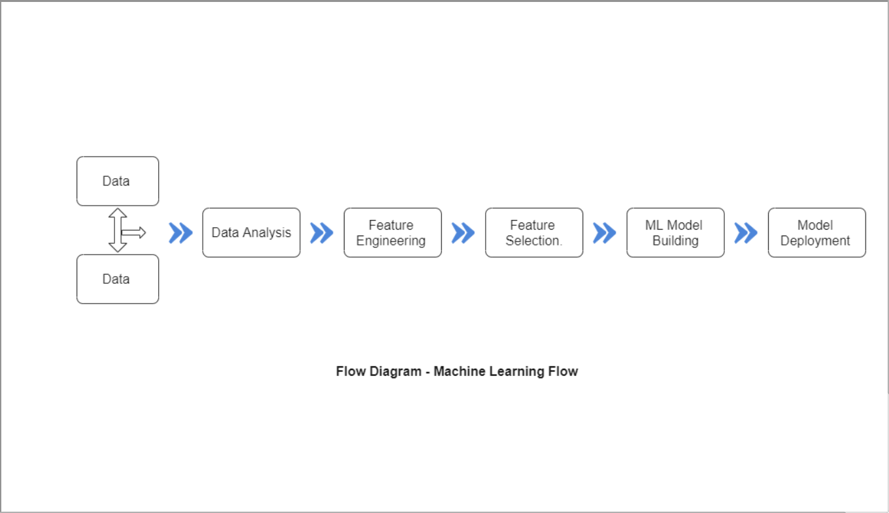
Project Flow and Working
Machine Learning Process

Slide 8
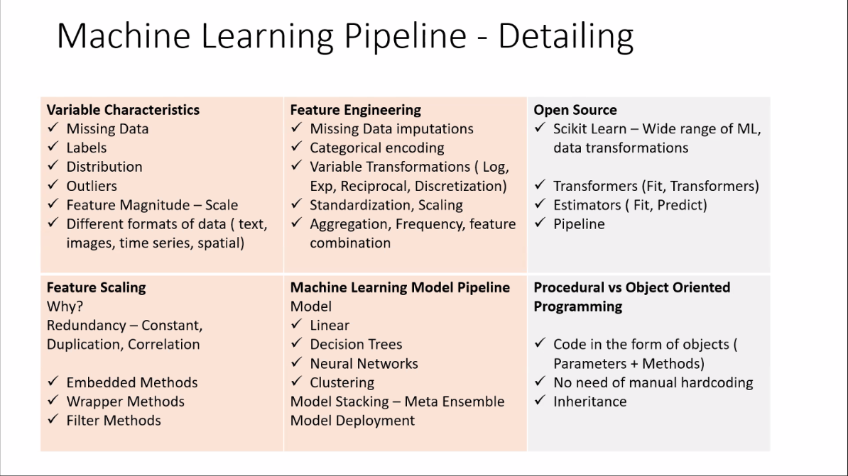

Slide 9
Web App working Flow
5
Predict the results
Enter the Symptoms
4
Select the disease to predict
3
Login the user
2
Register the User
1

Slide 10
Applications
To contribute towards healthcare sector so that it ease for Doctors and patients to get all idea about the disease or cancer.
The purpose is to utilize the ML algorithm and to save onces life

Slide 11

Advantages
One place prediction
No extra hardware needed
Received Predicated Report
Remote point access
Easy Access
User Friendly
Time Saving Prediction System

Slide 12

Disadvantages
Required Internet Access
User need to enter proper symptom

Slide 13
Scope of project
This project helps in medical field.
It helps Patients and doctors to get ease understanding about what issue or disease a patient is facing and how to treat that disease.
As it is ML based project it also help to predict which types of disease it if the disease have several types.

Slide 14

Future Scope of Disease Prediction System
Doctor authentication will apply to the web application
So Doctor Login will be also provide to application
Patient can take doctor appointment.
More Diseases can be added for Prediction

Slide 15
Question and Answer
Questions
Processing
Your
Question
Answers

